Slide 1


Analyzing YouTube Data
Anjitha Antony(C0796673)
Ashna Kunnathully Prasannan(C0786430)
Rincy Jose(C0790298)
Shilpa Thomas(C0800534)

Slide 2
Introduction
YouTube is the biggest and well-know video-sharing website on the Internet
API will enable you to get almost all of the YouTube data.
Notes:
YouTube is a well-known and widely utilized internet video platform in today's world. YouTube maintains a list of popular videos that is updated regularly. Analyzing the data can give insights into YouTube trending videos, to see what is common among those. People who desire to boost the popularity of their YouTube videos could benefit from these insights. This paper can help in finding, measuring, analyzing, and comparing key aspects of YouTube trending videos.

Slide 3
Objective
To extract YouTube video details using video Id.
Analysis of extracted data.
Extraction of comments from YouTube.
Sentiment analysis on extracted comments.

Slide 4
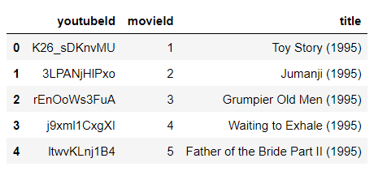
Meet Our Dataset
Dataset comprises
: 25623 instances
: 3 attributes
Consists of 3 columns:
YouTube id
Movie id
Title

Slide 5

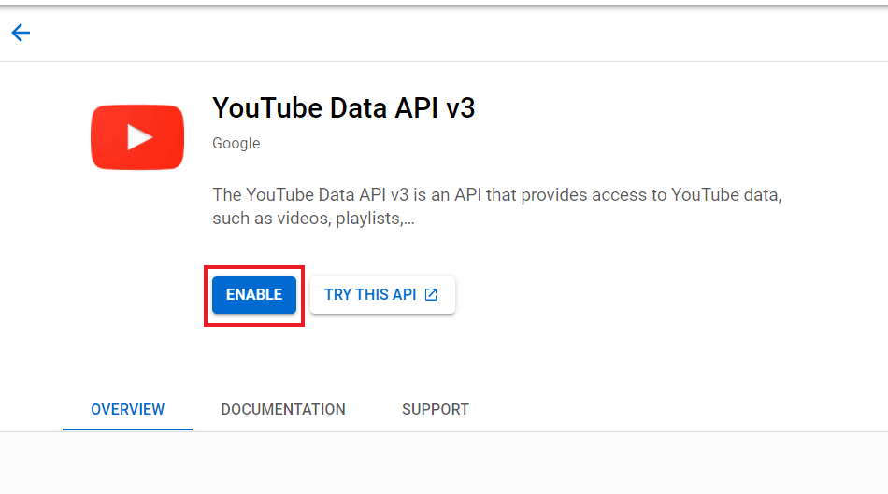
Extraction of YouTube Videos
Created the YouTube API to make API requests to retrieve information.
Notes:
To generate an API key navigate to Google's API Console (https://console.developers.google.com/apis/ ) and from the credentials, create a new credential as shown below.
In the next phase, select the desktop app as the application type and gave a name for the project then create. The newly generated API key is displayed and click on Enable.

Slide 6
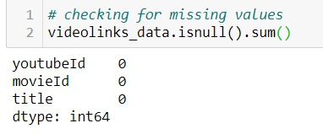
Data Pre-Processing
no null values

Slide 7
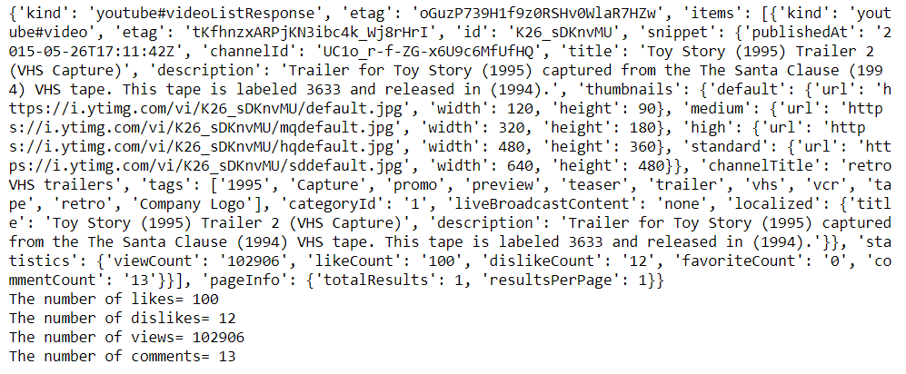

Data Analysis
Getting Video Details
Deleting Duplicate YouTube IDs

Slide 8
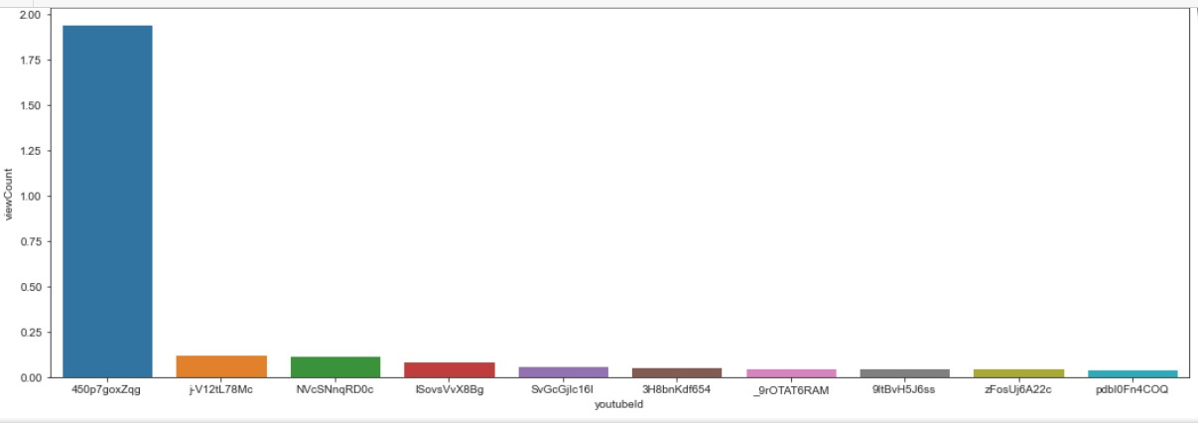
Data Analysis(Cont.)
Top 10 most viewed videos from the dataset

Slide 9
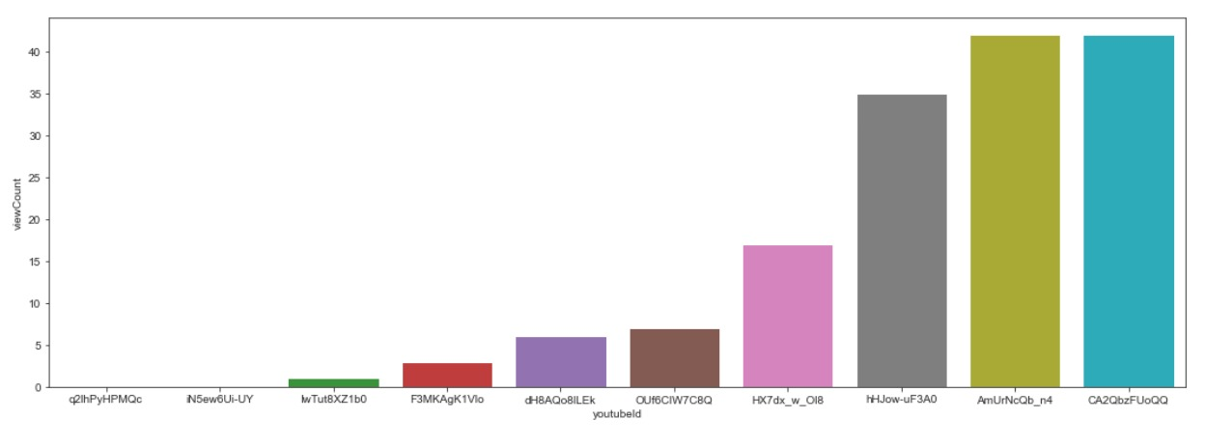
Data Analysis( Cont.)
Top 10 least viewed videos from the dataset

Slide 10
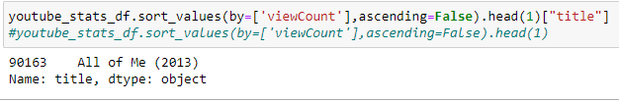

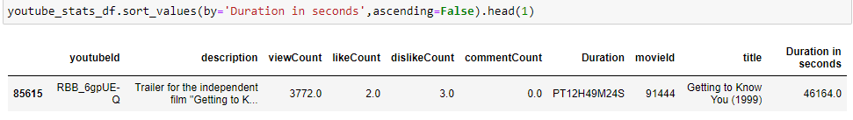
Data Analysis( Cont.)
Title of most liked video
Title of least liked the video
Title of the video with the highest duration

Slide 11
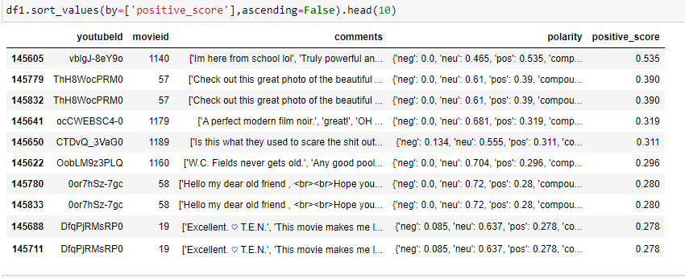
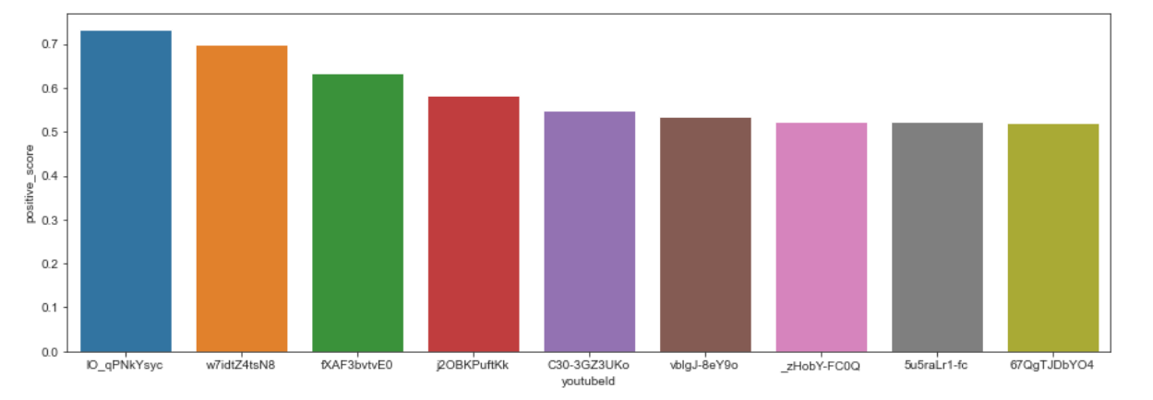
Extracting the comments from the YouTube ids
Sentiment analysis of comments

Slide 12
Conclusion
Our findings for measuring, assessing, and comparing essential characteristics of YouTube popular videos were reported in this study.
Understanding these statistics will aid YouTube in not only developing better video processing algorithms but also in making judgments for individual YouTubers.

Slide 13
References
C. Reed, T. Elvers, and P. Srinivasan, "What’s Trending? Mining Topical Trends in UGC Systems YouTube as a Case Study", MDMKDD , New York, 2011, No. 4.
M. Thelwall, P. Sud, and F. Vis, "Commenting on YouTube videos: From guatemalan rock to El Big Bang", Journal of the American Society for Information Science and Technology , 2012, Vol 63,pp. 616-629.
YouTube data API documentation: https://developers.google.com/youtube/2.0/reference
R. Zhou, S. Khemmarat, and L. Gao, “The impact of YouTube on recommendation system on video”, IMC New York, pp. 404-410, 2010
https://console.developers.google.com/apis/

Slide 14
Thank You

